Slide 1
LEADERSHIP SURVEY GROUP REPORT
Sample Leadership Group
31 July 2023

Slide 2
ABOUT THIS REPORT
This report presents aggregate results of a leadership and employee engagement survey. The information contained is sensitive, private and confidential. Every effort should be made to ensure that this report is stored in a secure place, provided only to the intended recipient(s) and used only for its express purpose. The survey and this report were designed by Genos International based on sound scientific theory and research. The results presented in this report are, however, based on individual raters’ views. As such, Genos International makes no warranties regarding the accuracy or reliability of the results. No advice or information contained in this report shall create any warranty not expressly stated herein. No person(s) should act or fail to act on the basis of the results contained in this report. Intended recipients should consult professional advice about any matter affecting them.
ABOUT GENOS
Genos helps leaders facilitate high performance in organisations. To learn more about our unique approach and the improvements we are generating in terms of productivity, profitability and customer loyalty visit our website at www.genosinternational.com
COPYRIGHT
Copyright © 2023 Genos International Pty Ltd
No part of this publication may be reproduced or retransmitted in any form or by any means electronic or mechanical, including photocopying, recording, or use of any information storage or retrieval system, for any purpose without the express permission from Genos International Pty Ltd.

Slide 3
Population Information
GROUP DESCRIPTION:
Sample Leadership Group
NUMBER OF PARTICIPANTS RATED:
7
NUMBER OF RATERS:
32
COMPLETED ENGAGEMENT SURVEYS:
9

Slide 4
RATER INFORMATION
Responses to the survey were collected between 24 July 2019 and 31 July 2019.
FAMILIARITY
THIS MEANS THAT RATERS...
SO SCORES FROM THIS CATEGORY ARE...
LOW
Have little contact with you and are unfamiliar with your leadership behaviours
Valuable and should not be dismissed. However, interpret these scores with caution.
MEDIUM
Have some contact with you and are familiar with your leadership behaviours
Meaningful. Identify actions to take on the basis of your results however validate these actions with your raters before implementation.
HIGH
Are highly familiar with your leadership behaviours
Very meaningful. Take action based on the feedback.
CONSISTENCY
THIS MEANS THE RATER RESPONSES TO THE SURVEY WERE...
Significantly inconsistent. This may be because:
LOW
• You display different behaviour to individual raters
• Raters may be seeing different aspects of your behaviour, or
• Different situations, relationships or environments had an impact on their responses.
When consistency of responses is low, interpret results with caution, as the results reflect averages that may not be meaningful.
MEDIUM
Somewhat consistent, as might be expected from a typical group of respondents.
HIGH
Highly consistent.

Slide 5
TOTAL EMOTIONAL INTELLIGENCE
Benchmarks | Average Demonstration: 56 | Standard Deviation: 16 | Minimum: 30 | Maximum: 78
Percentage of the group that are high, average and low in Total Emotional Intelligence

Slide 6
SELF-AWARENESS
Benchmarks | Average Demonstration: 55 | Standard Deviation: 15 | Minimum: 38 | Maximum: 79
Percentage of the group that are high, average and low in Self-Awareness

Slide 7
SELF-AWARENESS
Benchmarks | Average Demonstration: 55 | Standard Deviation: 15 | Minimum: 38 | Maximum: 79
Question
I
D
d
BM
1.
˂˃
Understands the impact their behaviour has on others.
4.3
3.9
0.4
2.
˂˃
Is aware of their strengths and limitations.
3.9
3.9
✓
3.
˂˃
Asks others for feedback on their leadership.
3.7
3.5
0.2
4.
˂˃
Responds effectively to feedback provided to them.
4.4
4.1
0.3
5.
˂˃
Is consistent in what they say and do.
4.5
4.2
0.3
6.
˂˃
Behaves in a way that is consistent with how they expect others to behave.
4.4
4.1
0.3
7.
˂˃
Demonstrates awareness of their mood and emotions.
3.8
3.8
✓
KEY: I = Level of Importance D = Level of Demonstration d = Difference BM = Benchmark

Slide 8
AWARENESS OF OTHERS
Benchmarks | Average Demonstration: 59 | Standard Deviation: 23 | Minimum: 27 | Maximum: 92
Percentage of the group that are high, average and low in Awareness Of Others

Slide 9
AWARENESS OF OTHERS
Benchmarks | Average Demonstration: 59 | Standard Deviation: 23 | Minimum: 27 | Maximum: 92
Question
I
D
d
BM
1.
˂˃
Makes others feel appreciated.
4.3
4.2
0.1
2.
˂˃
Adjusts their style so that it fits well with others.
3.8
3.8
✓
3.
˂˃
Notices when someone needs support and responds effectively.
4.4
4.2
0.2
4.
˂˃
Accurately views situations from the perspective of others.
4.0
4.0
✓
5.
˂˃
Acknowledges the views and opinions of others.
4.3
3.9
0.4
6.
˂˃
Accurately anticipates responses or reactions from others.
4.1
3.7
0.4
7.
˂˃
Balances achieving results with others’ needs.
4.1
3.9
0.2
KEY: I = Level of Importance D = Level of Demonstration d = Difference BM = Benchmark

Slide 10
AUTHENTICITY
Benchmarks | Average Demonstration: 59 | Standard Deviation: 18 | Minimum: 34 | Maximum: 88
Percentage of the group that are high, average and low in Authenticity

Slide 11
AUTHENTICITY
Benchmarks | Average Demonstration: 59 | Standard Deviation: 18 | Minimum: 34 | Maximum: 88
Question
I
D
d
BM
1.
˂˃
Is open about their thoughts, feelings and opinions.
3.9
3.7
0.2
2.
˂˃
Expresses thoughts and feelings in a way that is sensitive to those of others.
3.8
4.1
✓
3.
˂˃
Facilitates robust, open debate.
4.2
3.9
0.3
4.
˂˃
Is open and honest about mistakes.
4.3
4.1
0.2
5.
˂˃
Honours commitments and keeps promises.
4.1
4.3
✓
6.
˂˃
Encourages others to put forward their thoughts, feelings and opinions.
4.2
4.1
0.1
7.
˂˃
Responds effectively when challenged.
4.1
4.0
0.1
KEY: I = Level of Importance D = Level of Demonstration d = Difference BM = Benchmark

Slide 12
EMOTIONAL REASONING
Benchmarks | Average Demonstration: 56 | Standard Deviation: 22 | Minimum: 21 | Maximum: 82
Percentage of the group that are high, average and low in Emotional Reasoning

Slide 13
EMOTIONAL REASONING
Benchmarks | Average Demonstration: 56 | Standard Deviation: 22 | Minimum: 21 | Maximum: 82
Question
I
D
d
BM
1.
˂˃
Consults others in decision-making.
4.1
3.9
0.2
2.
˂˃
Explains the rationale behind decisions made.
4.2
4.0
0.2
3.
˂˃
Involves you in decisions that affect your work.
4.1
4.1
✓
4.
˂˃
Considers issues from multiple perspectives.
4.3
4.1
0.2
5.
˂˃
Takes the bigger picture into account when decision-making.
4.4
4.1
0.3
6.
˂˃
Reflects on feelings when decision-making.
3.6
3.8
✓
7.
˂˃
Makes ethical decisions.
4.5
4.4
0.1
KEY: I = Level of Importance D = Level of Demonstration d = Difference BM = Benchmark

Slide 14
SELF-MANAGEMENT
Benchmarks | Average Demonstration: 52 | Standard Deviation: 10 | Minimum: 37 | Maximum: 63
Percentage of the group that are high, average and low in Self-Management

Slide 15
SELF-MANAGEMENT
Benchmarks | Average Demonstration: 52 | Standard Deviation: 10 | Minimum: 37 | Maximum: 63
Question
I
D
d
BM
1.
˂˃
Manages their emotions effectively in difficult situations.
3.9
3.9
✓
2.
˂˃
Demonstrates a positive, energising demeanour.
3.9
4.1
✓
3.
˂˃
Manages their time effectively.
4.1
4.1
✓
4.
˂˃
Learns from mistakes.
4.1
4.1
✓
5.
˂˃
Keeps up to date with industry trends and market conditions.
4.1
4.1
✓
6.
˂˃
Strives to improve their own performance.
3.9
4.2
✓
7.
˂˃
Quickly adapts to new circumstances.
4.2
4.2
✓
KEY: I = Level of Importance D = Level of Demonstration d = Difference BM = Benchmark

Slide 16
INSPIRING PERFORMANCE
Benchmarks | Average Demonstration: 51 | Standard Deviation: 23 | Minimum: 9 | Maximum: 79
Percentage of the group that are high, average and low in Inspiring Performance

Slide 17
INSPIRING PERFORMANCE
Benchmarks | Average Demonstration: 51 | Standard Deviation: 23 | Minimum: 9 | Maximum: 79
Question
I
D
d
BM
1.
˂˃
Provides useful support and guidance.
4.4
4.1
0.3
2.
˂˃
Provides constructive feedback on behaviour and performance.
3.9
3.9
✓
3.
˂˃
Helps you understand your purpose and contribution to the organisation.
3.9
3.7
0.2
4.
˂˃
Notices inappropriate behaviour in others and responds effectively.
4.0
3.8
0.2
5.
˂˃
Maintains a positive work environment.
4.2
3.9
0.3
6.
˂˃
Helps facilitate your development and advance your career.
4.0
4.0
✓
7.
˂˃
Recognises others’ hard work and achievements.
4.2
4.2
✓
KEY: I = Level of Importance D = Level of Demonstration d = Difference BM = Benchmark

Slide 18
EMPLOYEE ENGAGEMENT OVERVIEW
Employee engagement is the collective level of intellectual and emotional commitment employees have toward their work and organisation. It is measured empirically by asking employees to indicate the extent to which they praise their organisation to others; perform beyond what is expected of them; persist in the face of adversity; and perfect what they do.
The items measuring these four value creating engagement factors are shown below.
Praise
I tell others how great this organisation is to work for whenever I have the chance.
In this report, total employee engagement is calculated at the individual level by averaging employee responses to the eight engagement questions shown opposite.
I promote this organisation as a great place to work.
My commitment to this organisation remains unwavering even when conditions become difficult.
Persist
I never think about leaving this organisation even when other opportunities are presented to me.
Perform
I willingly perform above and beyond what is expected of me at work.
The way I feel about this organisation motivates me to do everything I can do to make this organisation successful.
Your Engagement Score represents the percentage of employees who have an average response to the questions between 6.50 - 8.00.
Perfect
I continuously seek to improve the way I do things for this organisation.
I am motivated to find new and innovative ways of doing things in this organisation.
Score Range
Interpretation
Absolutely Disagree
Strongly Disagree
Moderately Disagree
Slightly Disagree
Slightly Agree
Moderately Agree
Strongly Agree
Absolutely Agree
6.50 - 8.00
Engaged
4.50 - 6.49
Nearly Engaged
1
2
3
4
5
6
7
8
2.50 - 4.49
Not Engaged
1.00 - 2.49
Disengaged

Slide 19
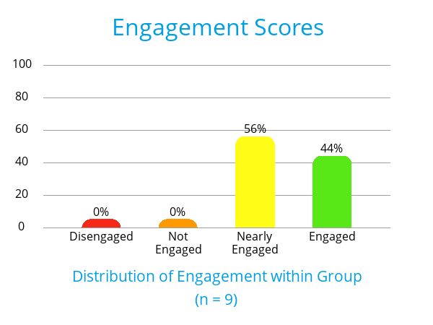
EMPLOYEE ENGAGEMENT SCORES
The engagement scores for this group are shown below.
Different businesses use different employee engagement surveys. Therefore comparisons with industry benchmarks should be made cautiously. However, most engagement surveys report overall engagement scores as a percentage of employees that are ‘engaged’ as per the aforementioned definition.
Below we report both Your Scores (YS), and our International Engagement Benchmark scores (BM). The Benchmark sample comprises responses from 26,118 individuals who have completed the Genos Engagement Survey coming from a wide variety of different organisations in the public and private sectors.
Comparison with Genos Benchmark
Category
BM
YS
Engaged
54%
44%
Nearly Engaged
39%
56%
Not Engaged
6%
0%
Disengaged
1%
0%
BM = Genos Benchmark YS = Your scores

Slide 20
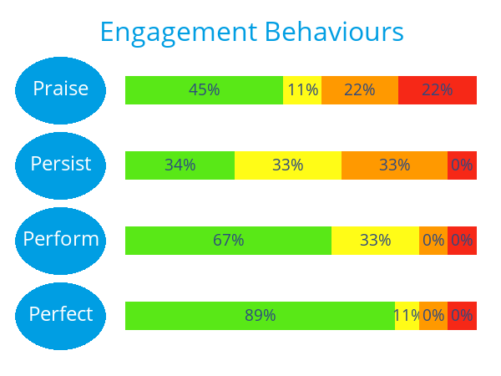
EMPLOYEE ENGAGEMENT SCORES
Scores across the four ‘P’s of the Genos Engagement model for this group are shown below together with Benchmarked Scores from the Genos sample (percentage in the green or ‘engaged’ category only).
Comparison with Genos Benchmark
Category
BM
YS
Praise
50%
45%
Persist
48%
34%
Perform
69%
67%
Perfect
72%
89%
BM = Genos Benchmark YS = Your scores

Slide 21
Global Headquarters Sydney
Phone:
+61 2 8004 0413
info@genosinternational.com
www.genosinternational.com
www.genosinternational.com/linkedin
www.genosinternational.com/facebook
www.genosinternational.com/instagram

